Slide 1

IT-648: IT Risk Management
Week 13
Sonja Streuber

Slide 2
Agenda
# | Topic | Reading | Due 11:59 pm CST on Blackboard
13 | Incident Analysis: Log analysis, Event criticality, General log configuration and maintenance, Live Incident response, Timelines, Other forensics topics | Agrawal 12 Other materials on Blackboard | W: Post F: Responses S: LAB_13

Slide 3
Chapter 12
Incident Analysis

Slide 4
Overview
By the end of this week, you will be able to:
Identify sources of information within popular operating systems
Extract information from specific systems
Create timelines indicating the pattern of an event
Analyze examples of evidence of attack on multiple applications

Slide 5
Log analysis
Most applications and operating systems provide logging mechanisms
Record status information
Various uses of logged information
Software Developers
Ensure the application is behaving as expected
Dump output of an internal command to the screen
Debug mode
System Administrators
Do performance analysis on a running application
Make sure application has enough memory and disk space to run properly
Use logs during the analysis stage of an incident
Probably the first desired item of information during an investigation

Slide 6
MS Windows (7 and 10)

Slide 7
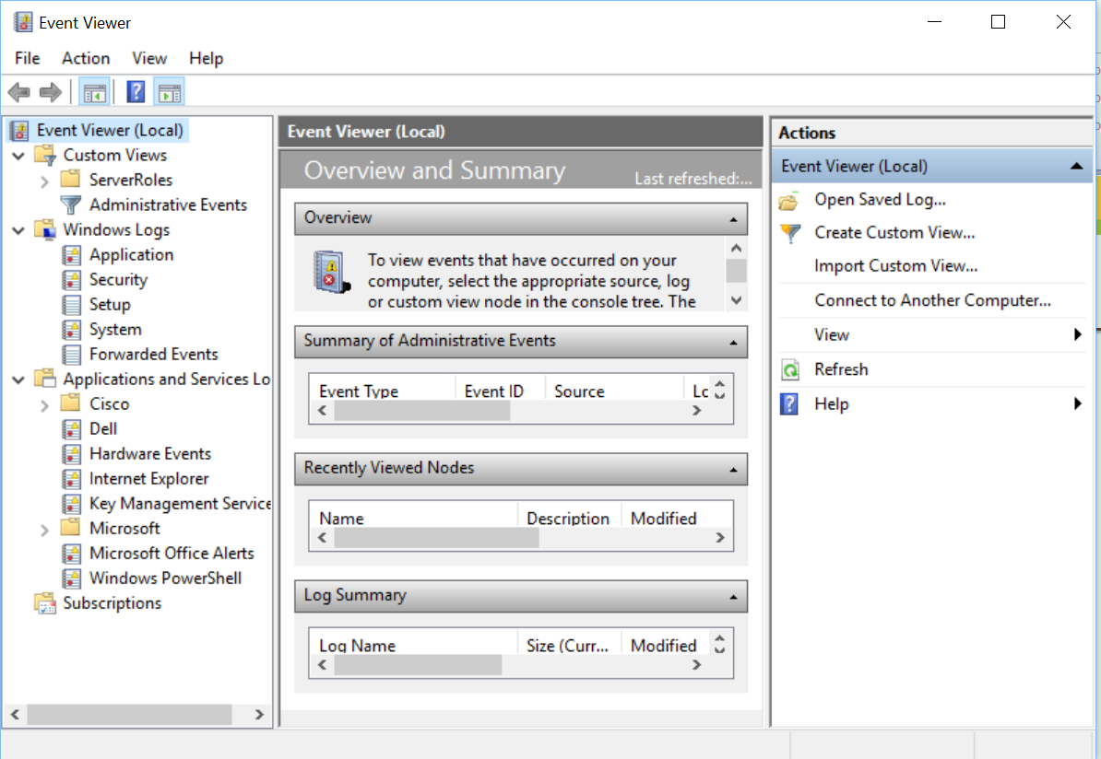
Windows logs
Referred to as “Event Logs”
Event viewer application
Native user interface to view logs
Other tools are also available
May provide improved features to dig into event log files
MS Windows 10 Event Viewer

Slide 8
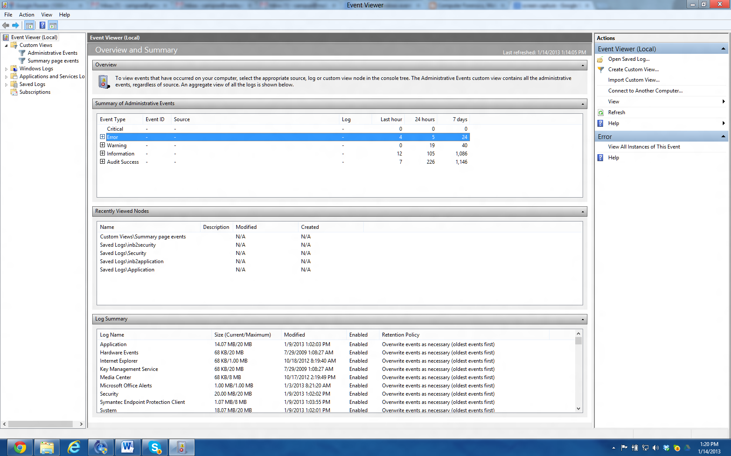
MS Windows Event viewer
MS Windows 7 Event Viewer
Control panel → Event Viewer
Navigation pane
Left pane
Means to look at different logs that exist on this system
Administrator can create custom views
Focus on specific targets
Home screen
Find your own Event Viewer on a Windows machine and walk through the screens featured in the following slides.

Slide 9
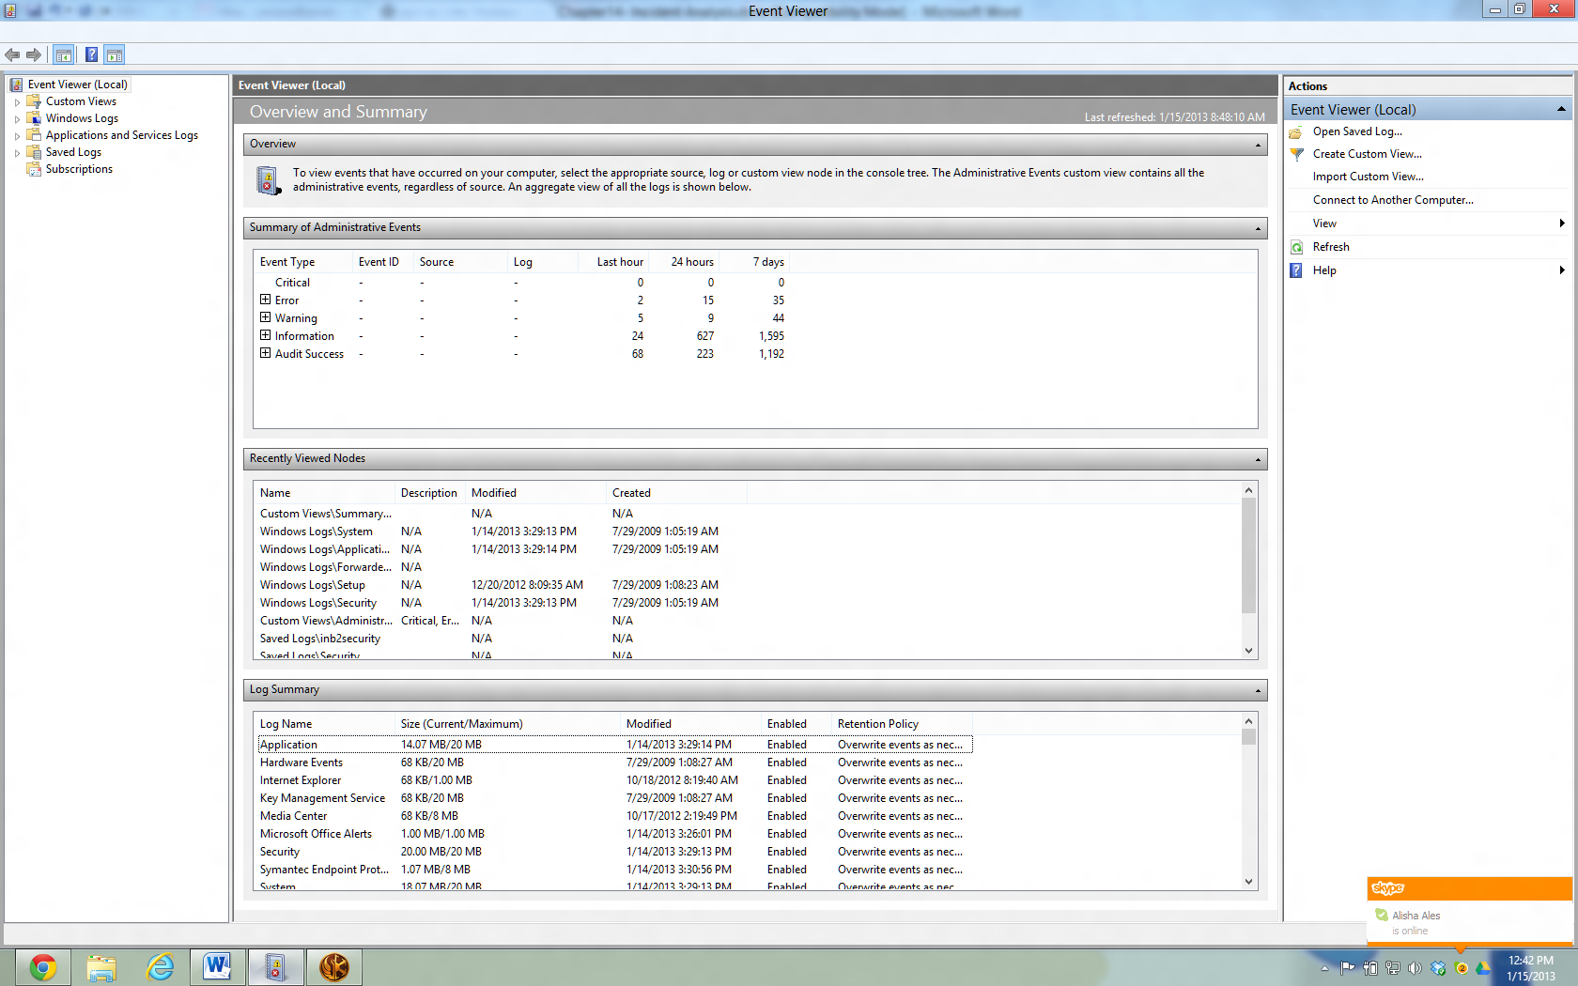
Event viewer home screen
Summary of Administrative Events Pane
This pane contains a breakdown on the number of events per event type. If the administrator expands the event type by clicking on the “+” button next to the type, the number of events under that particular event type is further broken down by Event ID. Event IDs are classes of events under a specific type.

Slide 10
Event viewer home screen
Recently viewed nodes pane
Latest event log files viewed
Contains
Description of the view (when available)
Date the log file (node) was last modified
When the file was originally created
Blank date lines indicate that the file was never created
Or log entries have never been appended to the file

Slide 11
Event viewer home screen – contd.
Log summary
Describes attributes of each log file currently kept by Windows
Size/Maximum Column
How much space is left for growth in the log file
Files nearing maximum indicate that records are rotating
Therefore likely being lost
Need to consider log life

Slide 12
Types of event log files
Application log
Logging information from 3rd party applications, and
MS applications not part of OS core distribution
E.g. video game log information, MS Office logs
Security file
Default - login and logout attempts
Can be configured to log data file activity
File creation, opening or closing
System event log file
Holds operating system log messages
E.g. network connection problems and video card driver errors
Setup node
Stores logging information regarding installation of software applications
Forwarded Events log
Discussed shortly
Since Windows 8
Since Windows XP

Slide 13
Windows Forensics Example
Screenshot from a compromised machine (next slide)
Computer had McAfee Antivirus running on it--“Event ID 5000”
Exported log
Therefore more event details not available; however included information points to “VirusScan Enterprise” as culprit
System administrator in organization would know
AV engine version at the time of this incident was 5.4.1
Compared with the 5.3.0 shown in the log
Hence virus scanner was not up to date on this particular machine
Internet search on “Event ID 5000” in connection with McAfee
Error possible if On Access protection did not start up successfully
Piece that keeps the machine from getting infected in real-time
Follow up: Was antivirus software running on this machine at all?

Slide 14
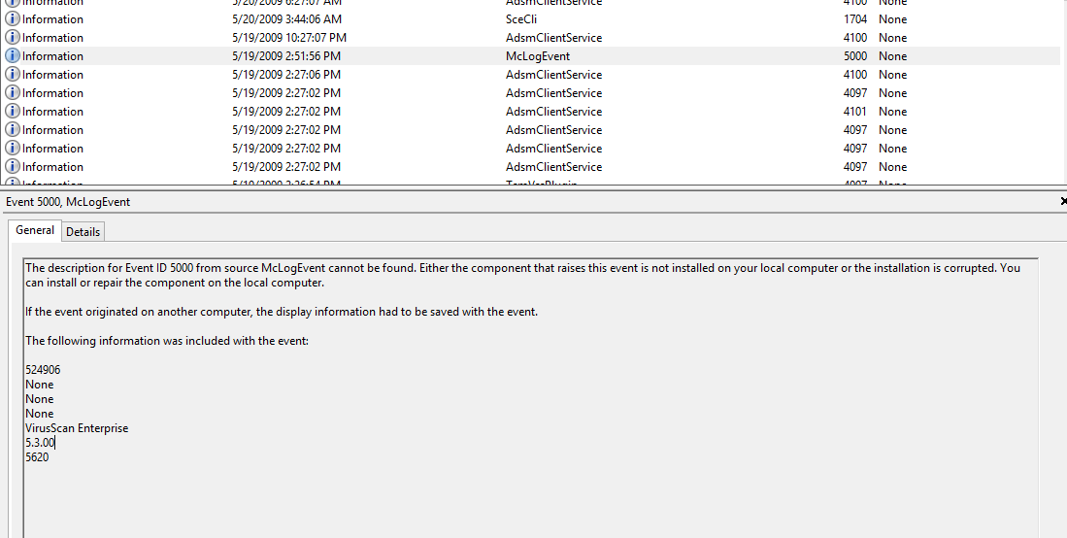
Windows forensics example – contd.

Slide 15
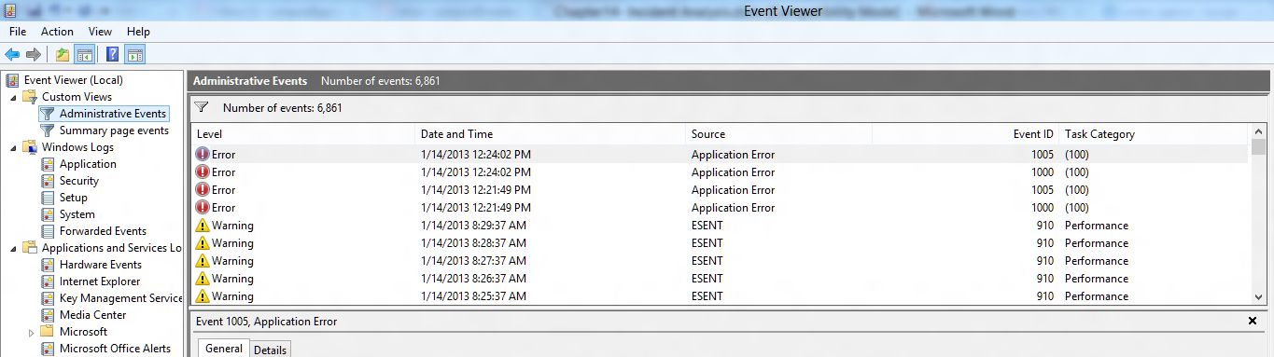
Event criticality
Log messages tagged with labels indicating their level of urgency
Custom View folder
“Administrative Events” Custom View
Installed by default in Windows 8
Provides view of all the “Critical,” “Error” and “Warning” events from all administrative logs

Slide 16
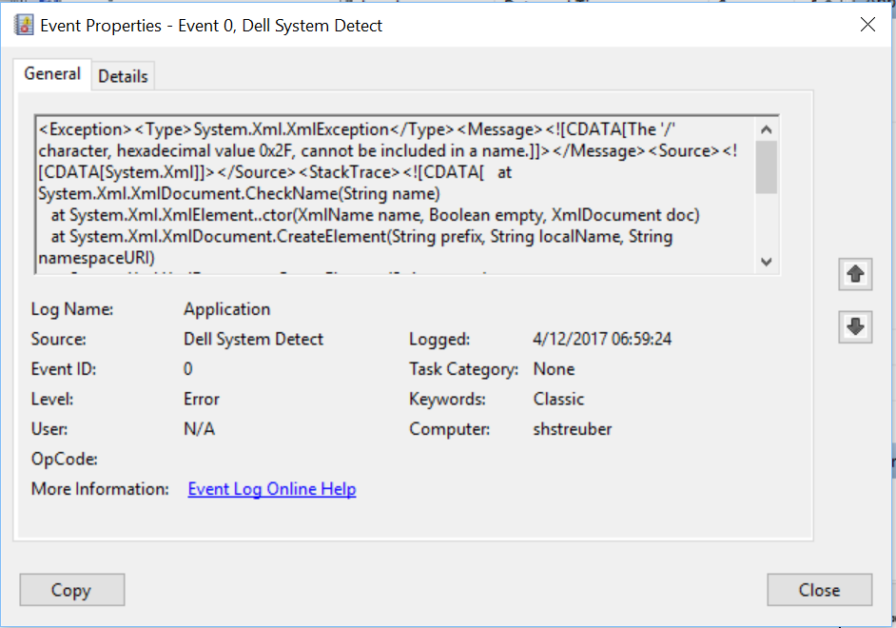
Event criticality in Windows
Information
Describes successful operation of a task
E.g. application, driver, or service
e,g. .when a network driver loads successfully
Warning
Not necessarily a significant event
However, may indicate the possible occurrence of a future problem
E.g, when disk space starts to run low
Error
Describes a significant problem
E.g. failure of a critical task
E.g. a service fails to load during startup
In your Event Viewer, locate an event of each criticality level, double click on it, and take a look at it.

Slide 17

Event criticality – contd.
Criticality levels defined by Windows
Success Audit (Security log)
Event that describes successful completion of an audited security event
E.g. a user logs on to the computer
Failure Audit (Security log)
Event that describes an audited security event that did not complete successfully
E.g. when a user cannot access a network drive

Slide 18
Unix

Slide 19
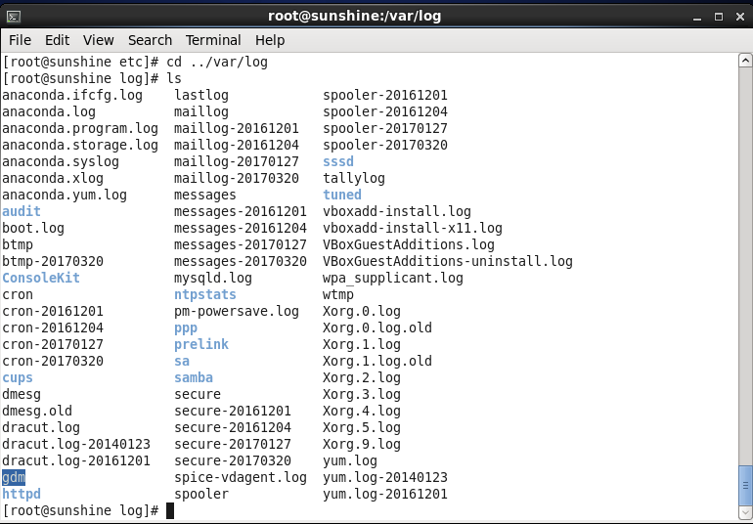
UNIX logs
Syslog
Service
File
Standard log files
Messages or syslog
Authentication log
Wtmp
Utmp
Web server logs
Netflow logs
Other logs
Equivalent to syslog on CentOS
Contents of /var/log on CentOS

Slide 20
Syslog
Syslog service
Process designed to handle messages for programs that are “syslog-aware”
Any programmer can use syslog facility
Store log information on a location specified in the syslog.conf configuration file
To use syslog service
Specify selectors
Two parts
Facility
Priority
Review /var/log/messages and /var/log/secure to determine what information each log holds.

Slide 21
Syslog facility
Specifies service that produced the error message
Defined services
E.g. auth, authpriv, cron, daemon, kern, lpr, and mail
For instance email subsystem log messages would be logged using the mail facility
Locally developed code
local0 through local7
Research which processes write to /var/log/message and /var/log/secure. Can you find the location of the .conf file for each of these processes?

Slide 22
Syslog priority
One of the following
debug, info, notice, warning, warn (same as warning), err, error (same as err), crit, alert, emerg, panic (same as emerg)
Classifies message by criticality
Priorities are additive
Messages with specified priority and all higher priorities will be logged
E.g. the selector mail.warn will match messages with the priority warn, err, crit and emerg

Slide 23
Syslog configuration
Specified in a configuration file
Composed by combining a selector coupled with an action
Action
Specifies what needs to be done when a matching message is generated
Could be
A filename, such as /var/adm/messages
A forward to the syslog service on another host
E.g. @hostname
Write the log information to the user’s screen
Specifying the username
* for all users

Slide 24
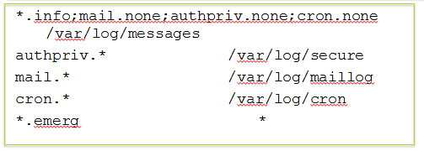
Syslog configuration example
Line 1
All messages classified as info or higher priority, regardless of facility (*.info) will be written to /var/log/messages
Exceptions to this rule are messages from mail, authpriv and cron facilities: None priority
Lines 2-4
All messages from specified facilities are written to their respective log files
Line 5
All messages with the priority of emerg
Typically only used if a system shutdown is eminent
Written to the screen of all users currently logged into the server (*)

Slide 25
Syslog configuration example
Syslog configuration allows administrator to specify location of logs
May choose locations different from the conventional location
/var/log
In an investigation
/var/log directory and its contents are empty
Does not mean someone removed them
Or that system does not log activity
Administrator may have put logs in a different location

Slide 26
Standard log files
Messages or syslog
/var/log/messages or /var/log/syslog
Default location of syslog service messages
Messages are designed for parsing by standard UNIX utilities
Authentication log
/var/log/secure or /var/log/auth.log
Records connection attempts and results of such attempts
Can indicate brute force connection attempts

Slide 27
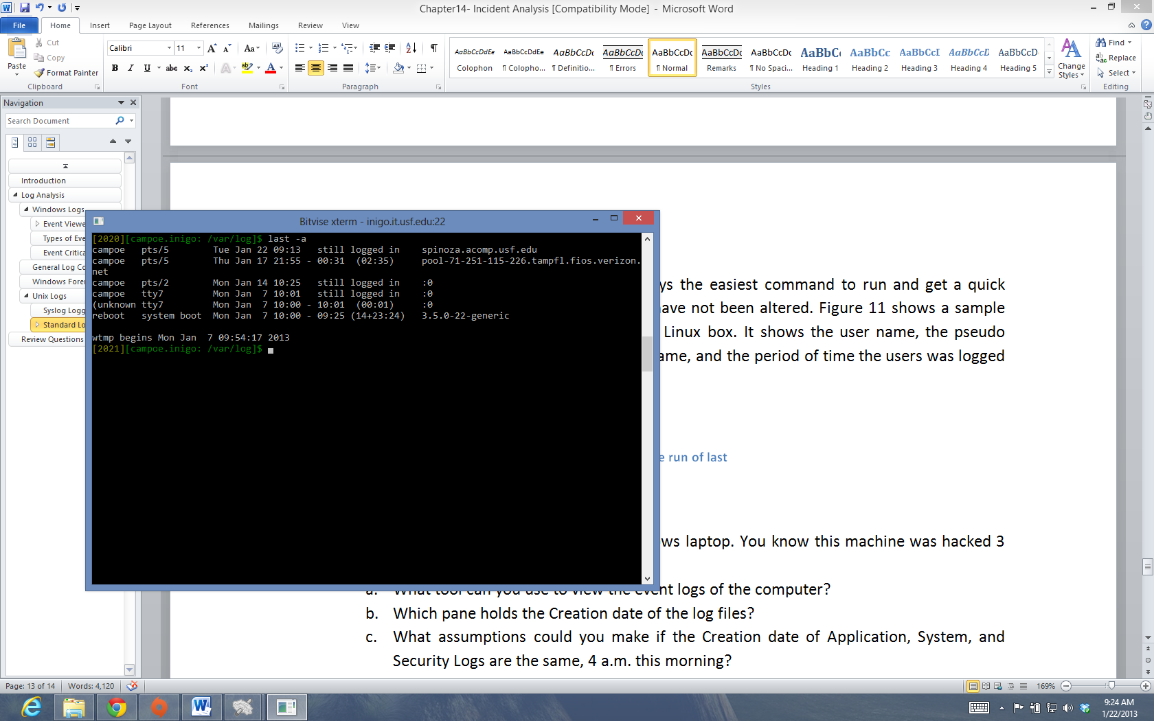
wtmp
/var/log/wtmp
Historical login and logout information
Binary file
Used by other commands
Who: Last logged in users
last: Recent reboots

Slide 28
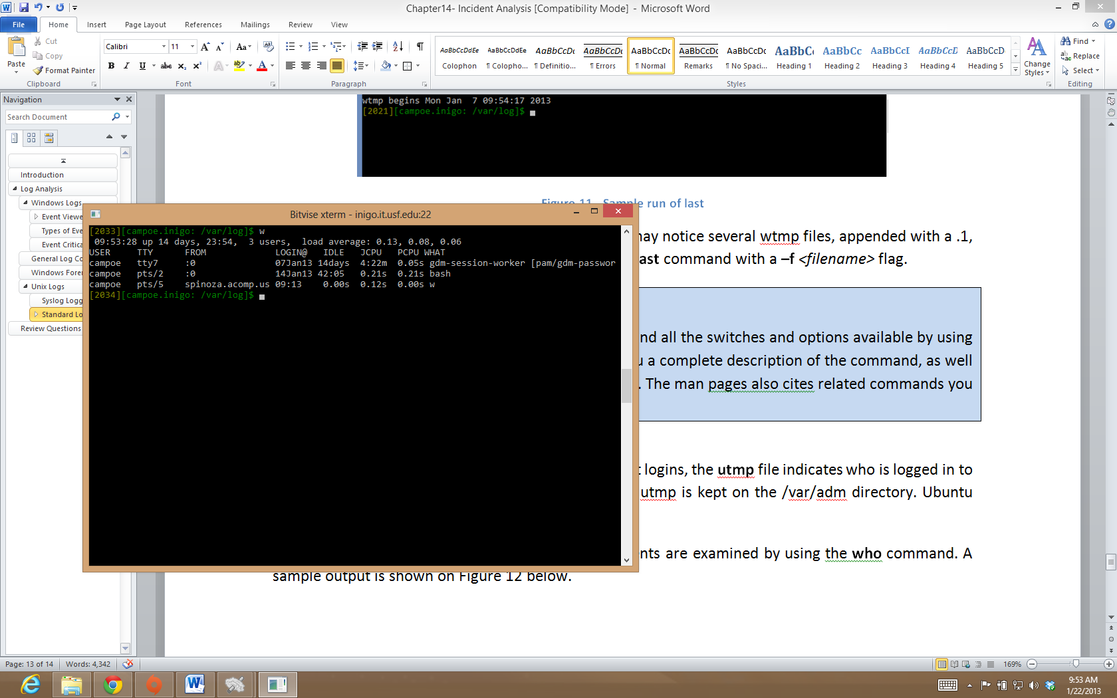
Utmp
Currently logged in users
Binary file
Located in
/var/run, or /var/adm
w command: If an unknown host is seen, enter incident response mode

Slide 29
Web server logs
Web servers are the most common attack path
Access and error logs can be useful sources of data
xxx.2xx.89.16 - - [09/May/2012:11:41:37 -0400] "GET /login HTTP/1.1" 404 338
xxx.2xx.89.16 - - [09/May/2012:11:41:37 -0400] "GET /sws/data/sws_data.js HTTP/1.1" 404 353
xxx.2xx.89.16 - - [09/May/2012:11:41:37 -0400] "GET /wcd/system.xml HTTP/1.1" 404 347
xxx.2xx.89.16 - - [09/May/2012:11:41:37 -0400] "GET /js/Device.js HTTP/1.1" 404 345
xxx.2xx.89.16 - - [09/May/2012:11:41:37 -0400] "GET /ptz.htm HTTP/1.1" 404 340
xxx.2xx.97.183 - - [09/May/2012:11:41:37 -0400] "GET / HTTP/1.1" 200 14257
xxx.2xx.97.183 - - [09/May/2012:11:41:37 -0400] "GET /authenticate/login HTTP/1.1" 404 352
xxx.2xx.97.183 - - [09/May/2012:11:41:37 -0400] "GET /tmui/ HTTP/1.1" 404 339
xxx.2xx.97.183 - - [09/May/2012:11:41:37 -0400] "GET /admin/login.do HTTP/1.1" 404 348
xxx.2xx.97.183 - - [09/May/2012:11:41:37 -0400] "GET /dms2/Login.jsp HTTP/1.1" 404 348
xxx.2xx.97.183 - - [09/May/2012:11:41:37 -0400] "GET /login HTTP/1.1" 404 339
xxx.2xx.97.183 - - [09/May/2012:11:41:38 -0400] "GET /sws/data/sws_data.js HTTP/1.1" 404 354
xxx.2xx.97.183 - - [09/May/2012:11:41:38 -0400] "GET /wcd/system.xml HTTP/1.1" 404 348
xxx.2xx.97.183 - - [09/May/2012:11:41:38 -0400] "GET /js/Device.js HTTP/1.1" 404 346
xxx.2xx.97.183 - - [09/May/2012:11:41:38 -0400] "GET /ptz.htm HTTP/1.1" 404 341
xxx.2xx.89.16 - - [09/May/2012:11:41:38 -0400] "GET /robots.txt HTTP/1.1" 404 343
xxx.2xx.89.16 - - [09/May/2012:11:41:38 -0400] "GET /CVS/Entries HTTP/1.1" 404 344
xxx.2xx.89.16 - - [09/May/2012:11:41:38 -0400] "GET /NonExistant1380414953/ HTTP/1.1" 404 355

Slide 30
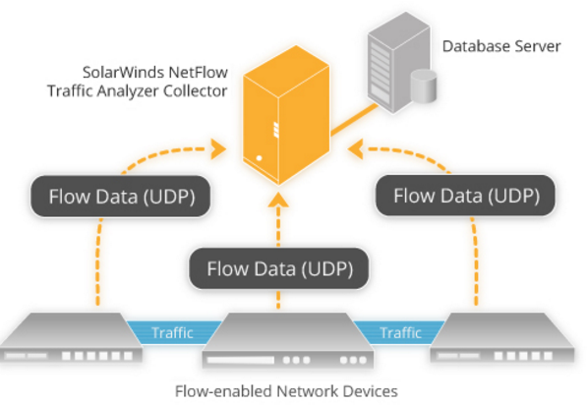
Netflow logs
Used by equipment vendors to collect IP traffic information
Developed by CISCO (now Solarwinds)
Can infer existence of web server at 222.243 in example
Watch for
Unusual ports
Excessive traffic volumes may indicate illegal downloads
Date Time Source Port Destination Port Packets
2011-12-01 00:11:19.285 66.2xx.71.155 34340 1xx.2xx.222.243 443 TCP 1 60
2011-12-01 00:11:46.659 61.1xx.172.2 35590 1xx.2xx.222.243 80 TCP 1 48
2011-12-01 00:18:58.992 71.xx.61.163 55194 1xx.2xx.222.243 80 TCP 3 152
2011-12-01 00:18:59.594 66.2xx.71.155 36614 1xx.2xx.222.243 443 TCP 3 180

Slide 31
Log configuration and maintenance
Default settings may not be most appropriate for your organization
Different audiences have different needs
Security analyst cares for login and logout information
First task
Determine the audience
Who will be interested in seeing the logs?
Is there a compliance issue that requires the logs to be set up and record a specific activity? E.g.
Legal requirement to record any and all access to Social Security Numbers stored in database?
Legal requirement to maintain log information for a certain number of days?

Slide 32
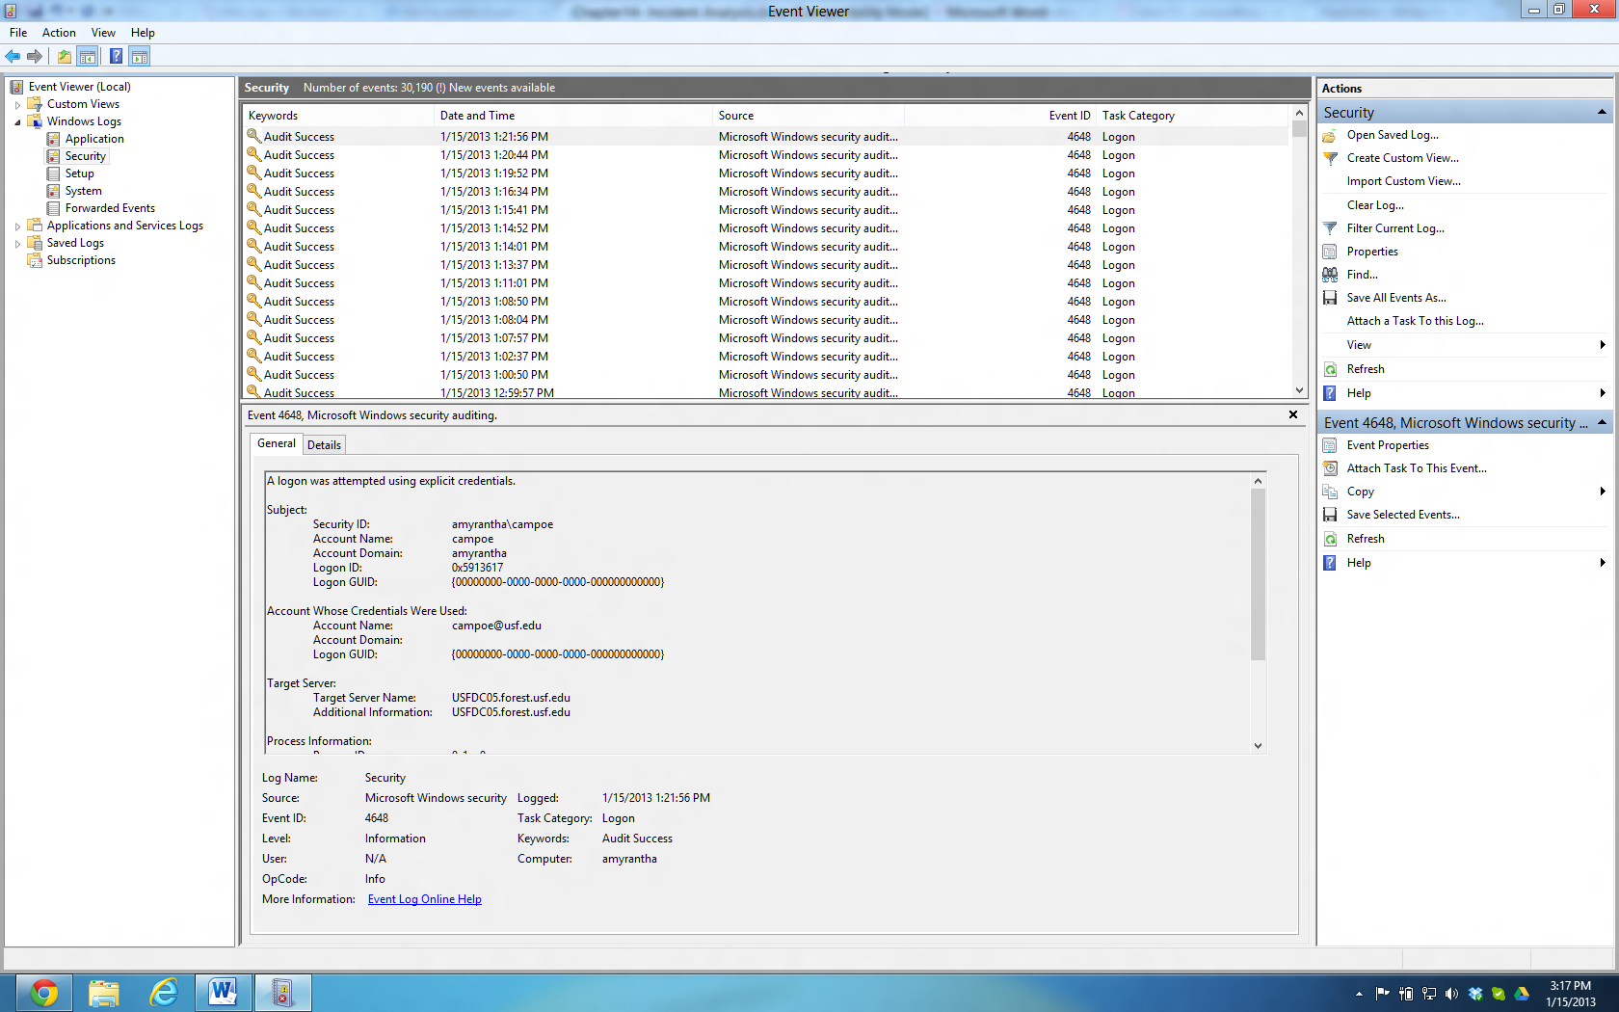
Log configuration and maintenance
Example
Security event log with default settings
Windows 8 Early Release
Records all successful logins
Log will fill up quickly
And rotate
Options
Increase log file size
Do not log successful logins
Miss attacker history
Rotate and archive old files

Slide 33
Log consolidation
Exporting logs from the original machine to a central box dedicated to log collection
Best option for security and compliance
Allows easier correlation of logs between different computers
Easy to see all connection attempts from one particular IP
Experienced attackers clear and disable all logs
Clear tracks
Exporting logs in real time to another machine retains pristine copy
Even if local logs are corrupted
Prevents accidental deletion
Can develop access policies for log machines
Server A Access Logs
Computer B Access Logs
Consolidated Logs
Network Router Logs
Database Logs Server A

Slide 34
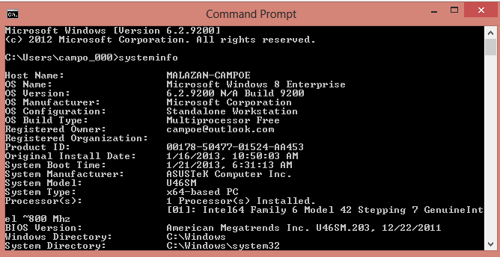
Live incident response
Collection of both volatile and non-volatile data while the system is up
Volatile data
Data that would be lost on a reboot of the system
E.g. running processes, volatile memory content, current TCP and UDP connections, etc
E.g. systeminfo (see figure)
Non-volatile data
Data stored in permanent storage devices, such as hard drives
First rule of forensics
Recover as much data as possible while the system is up and running
If at all possible

Slide 35
Live incident response
At times, depending on the damage being caused
Have to disconnect machine from the network before recovering data
E.g. attacking other machines
Collected data must be shipped off the machine to a forensics workstation
Popular applications used to send data include netcat and cryptcat
Netcat sends data over a TCP connection
Cryptcat is encrypted version of netcat
Systeminfo
Usually one of the first commands used by hackers
Find out how powerful the machine is and how much storage is available
Also specifies which patches have been applied to the system

Slide 36
Live incident response – contd.
Collected data must be shipped off the machine to another workstation
Called forensics workstation
Popular applications used to send data include netcat and cryptcat
Netcat sends data over a TCP connection
Cryptcat is the encrypted version of netcat
Systeminfo
Usually one of the first commands used by hackers
Find out how powerful the machine is and how much storage is available
Also specifies which patches have been applied to the system
Restore files
Obtaining files used in an attack
E.g. binaries used and logs generated by hackers

Slide 37
MAC times
Modification, Access and Creation times
Associated with data files
Modification Time
Indicates the time the file was last modified
Access Time
Points to the time the file was last accessed or read
Not very trustworthy
Affected by virus scanners, disk defrag applications etc
Hence often disabled by system administrators to improve file system performance
Creation Time
Time when the file was created

Slide 38
MAC times – contd.
Assume netflow logs reveal a suspicious SSH connection to a server
Netflow log gives timestamp associated with the connection
Also reveals lot of data was dropped on the system
Need to identify “what” was dropped
How to search?
Build server file timeline
Determine files created around the time found on the netflow logs
File → right click → Properties
Or Windows Explorer for a whole directory
To examine an entire drive
Forensic utilities are useful
E.g. mac_robber

Slide 39
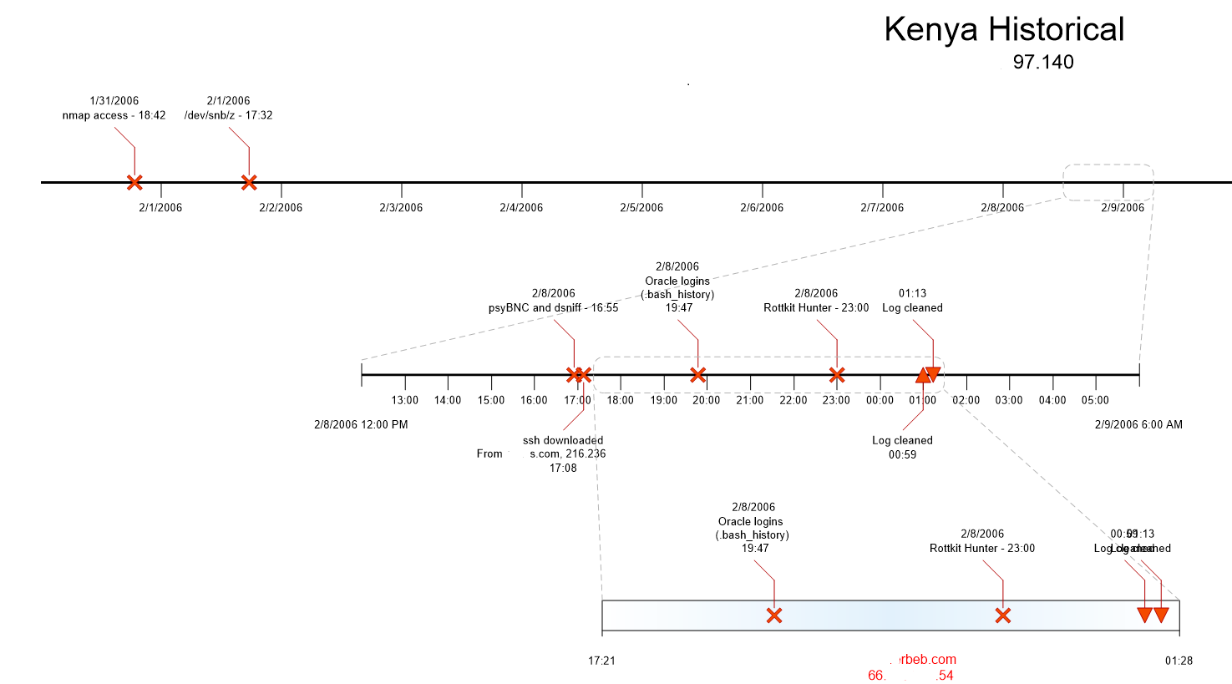
Timelines

Slide 40
Timelines
Used to visualize all information about an incident
Big part of forensics work
Developing timelines on multiple machines
Correlating them with each other and with network logs
Example shows simple timeline
1 of 5 different servers involved in an incident in 2006
Resulting report 15 pages long
Questionable activities on Kenya server corroborated on other servers
Scans initiated on Kenya detected on Server A and vice versa.
Entire timeline built from log files found on the five servers

Slide 41
Other forensics topics
IT Forensics is an extremely broad topic
Proficiency only comes with experience
Training is a constant
Computerized devices with network ability expand constantly
E.g. Smartphones to smart thermostats
New developments worth mentioning
Cloud storage such as Dropbox
Files stored on Dropbox almost immediately shared with multiple computers
Files “deleted” on a computer Dropbox folder not deleted on the Dropbox web portal
Easily restored
Question
How much access does an investigator have to Dropbox logs? Would it require a subpoena?

Slide 42
Chapter Review Questions (1)
What is incident analysis? What is the goal of incident analysis?
What is log analysis? What is the goal of log analysis?
Open up the Event Viewer on your computer. What is the most recent event in the Administrative Events pane?
What is the most recent entry in the recently viewed nodes pane?
What are the different levels of log criticality typically reported by Windows systems?
How can event criticality information in the Windows logs be useful?
What are the common locations of log files on Unix- based systems?
What is the syslog service?
What are syslog selectors?
What are the parts of a syslog selector?
What is the authentication log in Unix? How can it be useful?
What is the wtmp file? How can the information in the file be useful?
What is the utmp file? How can the information in the file be useful?

Slide 43
Chapter Review Questions (2)
What information is commonly available from web server logs?
What are some of the benefits of log consolidation?
What is live incident response? Why is it important?
What are some basic principles of live incident response?
Why are timestamps important in incident analysis?
What are MAC times?
What is an incident timeline? Why is it useful?
What incident analysis issues are raised by popular cloud storage services such as DropBox?
The following questions relate to your analysis of a faculty members hacked Windows laptop. You know this machine was hacked 3 days ago.
What tool can you use to view the event logs of the computer?
Which pane holds the Creation date of the log files?
What assumptions could you make if the Creation date of Application, System, and Security Logs are the same, 4 a.m. this morning?
Is there a way to have an educated opinion about the last time the hacker accessed the laptop?

Slide 44
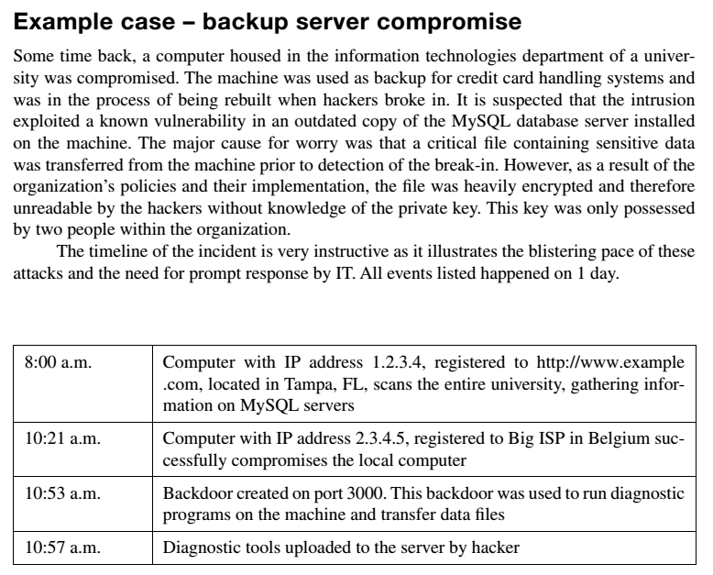
Example Case: Backup Server (1)

Slide 45
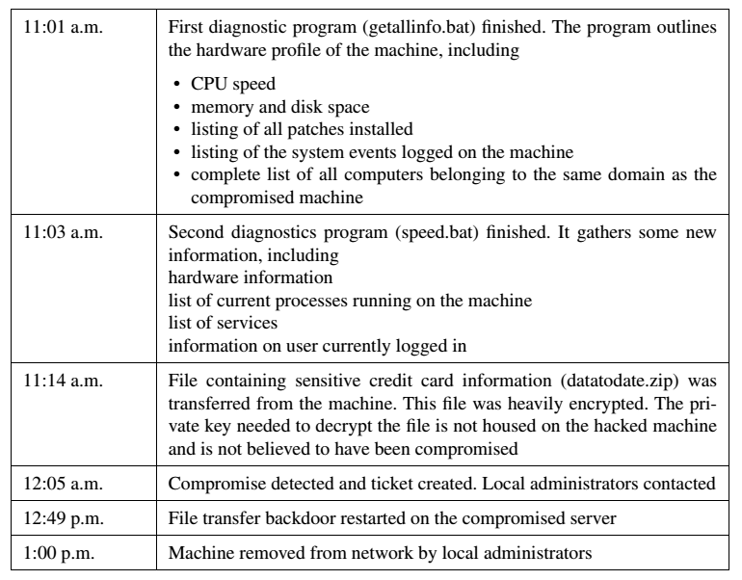
Example Case: Backup Server (2)

Slide 46
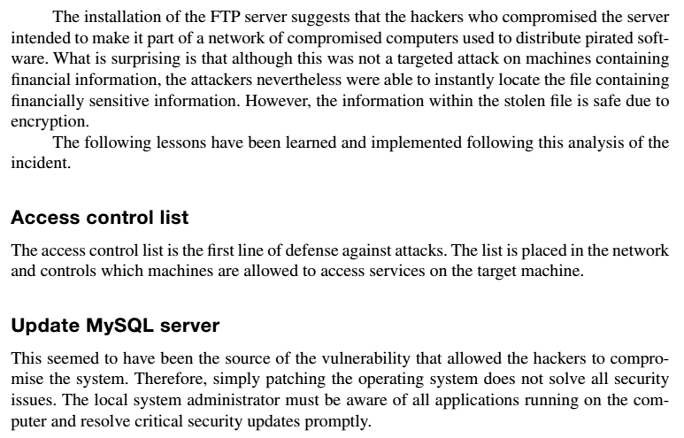
Example Case: Backup Server (3)

Slide 47
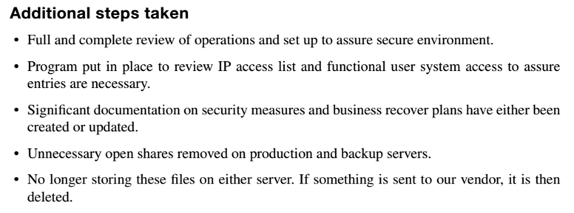
Example Case: Backup Server (4)

Slide 48
Example Case Questions
How much time elapsed between the start of the scan and the theft of the file containing credit card information?
Had the attack gone unnoticed, what potential harm could have happened to the university?
What are some ways in which the detection of the inci- dent could have been expedited?

Slide 49
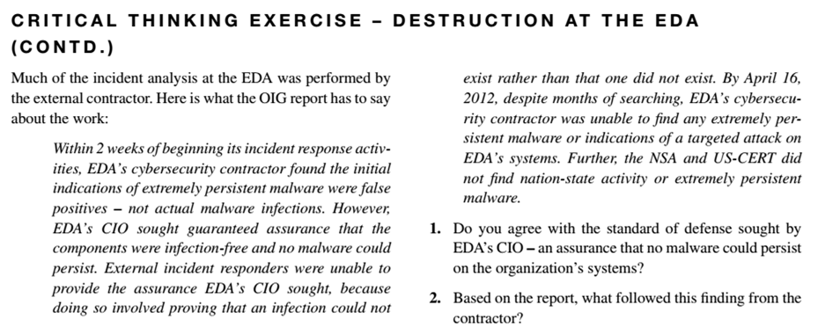
Critical Thinking Exercise

Slide 50
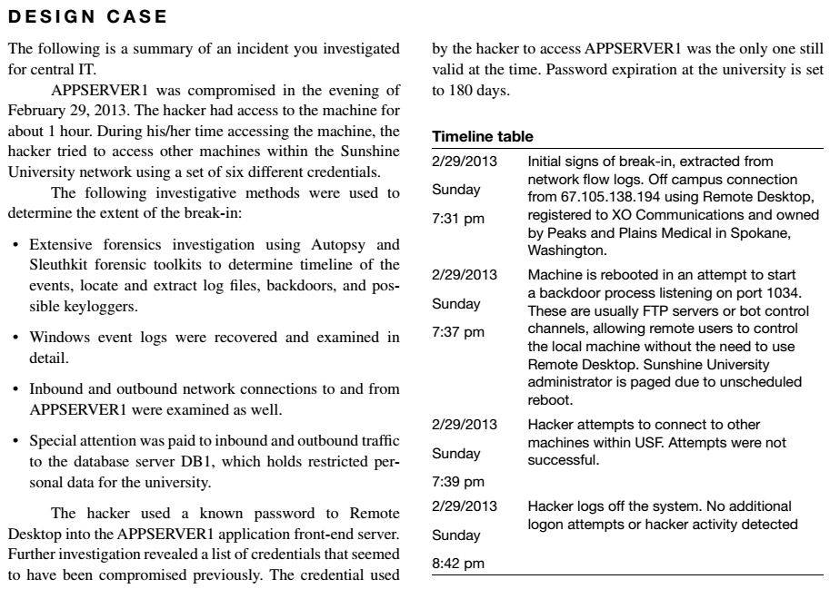
Design Case

Slide 51
Design Case Questions
When was the incident discovered and how?
What critical pieces of information are missing?
Based on what you know, what else would you consider looking into in order to make a better determination of the final consequences of the incident? Be as detailed as you can.
What would be your recommendations for improvement?

Slide 52
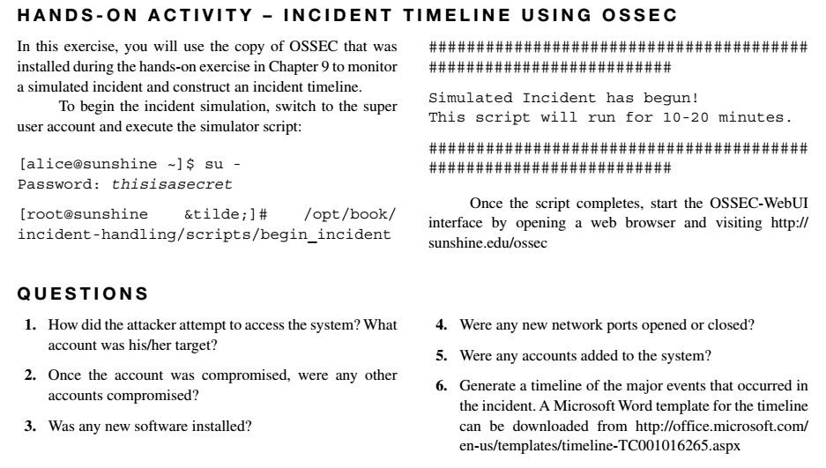
Hands-On Activity

Slide 53
Discussion 13
POST (due WED 11:59 pm CST): The following question relate to your analysis of a faculty member’s hacked Windows 7 laptop. You know this machine was hacked 3 days ago. Describe how you would review the logs. What assumptions could you make if the Creation date of Application, System, and Security Logs are the same, 4 a.m. this morning?
RESPONSES (due FRI 11:59 pm CST): Respond to two of your peers. Is their analysis correct and complete? How can you determine the last time the hacker accessed the laptop?

Slide 54
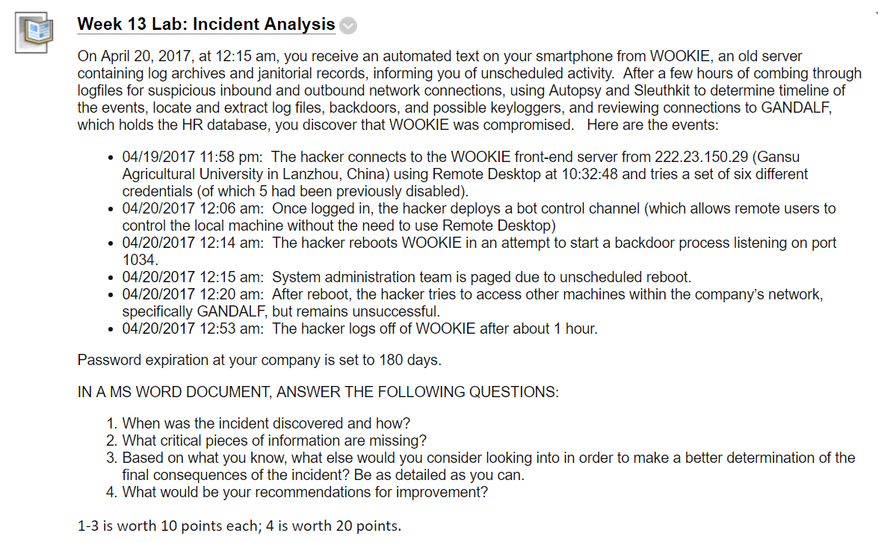
Homework Lab_13

Slide 55
Summary
Identify sources of information within popular operating systems
Extract information from specific systems
Create timelines indicating the pattern of an event
Analyze examples of evidence of attack on multiple applications

Slide 56
For Next Week
# | Topic | Reading | Due 11:59 pm CST on Blackboard
14 | Policies, Standards, and Guidelines: Writing a policy, Impact assessment and vetting, Policy review, Compliance, Key Policy Issues | Agrawal 13 Other materials on Blackboard | W: Post F: Responses S: LAB_14

